Slide 1
LA Solutions
Jon Summers
Be Communities Most Valued Professional
www.la-solutions.co.uk

Slide 2
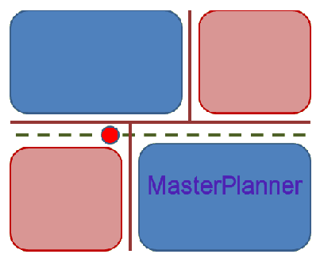
MasterPlanner™
BIM for MicroStation CONNECT
LA Solutions

Slide 3
MasterPlanner
Defines…
  Land Use Item Type
  Properties relevant to land parcels
  Reports
Tools operate on DGN closed elements…
  Tag and label
  Query
  Edit
Reports
  FlexiTable™
  MicroStation

Slide 4
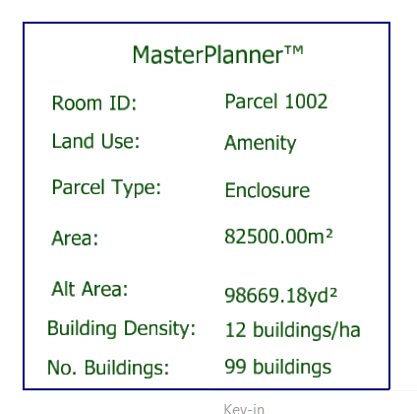
Annotation
Labels created from your design template
Land Use properties update automatically
DGN element properties update automatically
  Area
  Perimeter

Slide 5
Batch or Bulk Tagging
Tag and label multiple shapes
  In selection set
  In fence
  On named level
Increment ID
Create label

Slide 6
Dual Metrics
Metric DGN model
Annotate using
  Metres, mm etc.
  Alternative metrics hectares, feet etc.
Both metric and alternative measurements update automatically

Slide 7
Building Count per Plot
You specify building density
MasterPlanner measures plot area
MasterPlanner calculates areaxdensity
Formula is included in FlexiTable™
  Data and formulæ can be exported to Excel

Slide 8
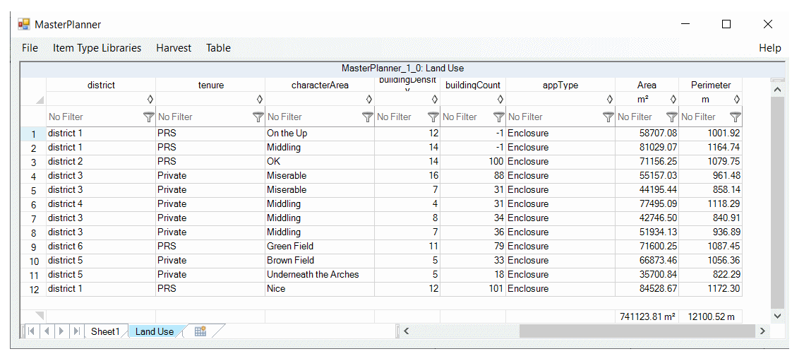
Reports
MasterPlanner delegates reports to FlexiTable™

Slide 9
MasterPlanner™
Created by LA Solutions
www.la-solutions.co.uk

